Slide 1
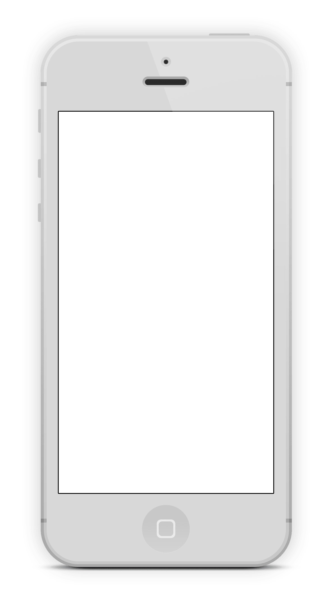
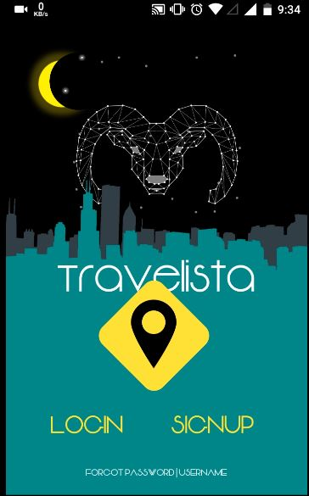
Travelista
Swastik Shrivastava WinCent

Slide 2
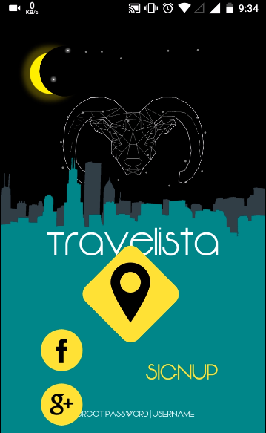
What is Travelista?
Travelista! An app for travelers ☺ Love Traveling ?
Features of this App :-
See best places to visit near you
Manage your activity through out the day
This app selects best Bike Trip for you
See hotels/restaurants near you to have a nice meal.
Get notifications from your friends who are near you

Slide 3
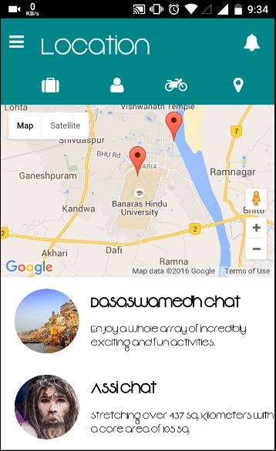
Location Nearby You!
From Location dashboard you can perform certain things:-
It lists out all the near by places that you can visit.
It marks those points on the Google Map. (Google Map and Places API Used)
Can see details in short about those places underneath.
The bouncing marker shows the current location of the user and then suggests places.
**there’s no login as this app is only meant for the competition.

Slide 4
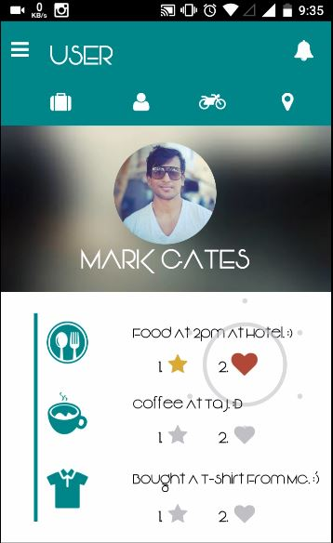
User Dashboard
If you tap on the user icon on the top you’ll land here!
From User dashboard, people can perform certain things:-
It tracks your daily activities that you perform.
You can Favorite (Star mark) those activities to share them later.
You can also heart your activities to remember those shops/places.

Slide 5
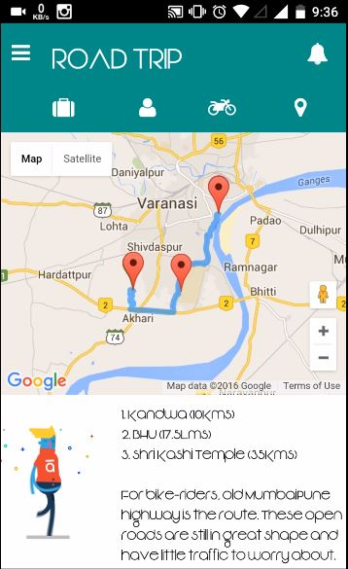
BIKE TRIP ?
This is one of the unique feature of this app. If you are in a random city and don’t know where to go or the best way for a bike trip, switch to Travelista! It suggests the best path for a road trip through which the person will be able to see the whole place in short! Gives you directions and shows the route on map. (Google Map API and Places API used).

Slide 6
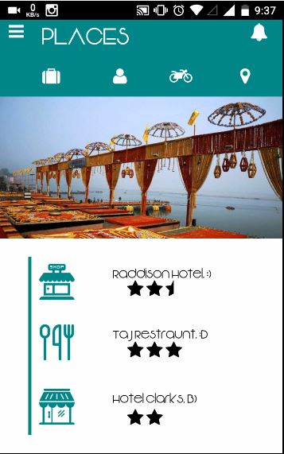
Want to have FOOD?
The Places tab tells you nearest best place to have your world class Italian, Spanish or Indian Cuisine. You can also see the glimpses of the city in images, just tap on the “Picture” to see the next image.
It rates those places out of 5 so that you can select the best out of the rest.
Suggestions are made using the current location.

Slide 7
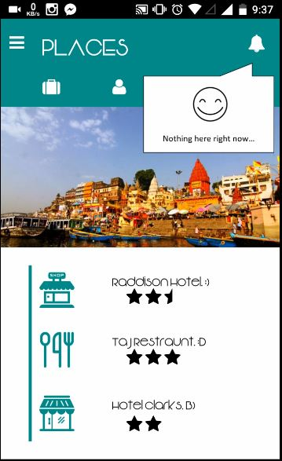
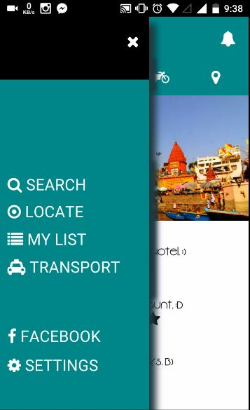
Other Features!
The bell symbol at the top tells you about you notifications that you get from your friends! The side bar can take you other tabs easily. (Have’nt added yet)

Slide 8
Benefits Over Other Apps!
This project is Cross-Platform. It is built using Apache Cordova.
A single code for all the platform like Android,
Windows Phone, iOS etc hence fewer people are required for the whole project. And hence we can target all the individuals of this nation.
Cost effective.
Accessible to all, irrespective of platform.
Less time for execution of app.
Web App and Phone App are build using HTML5 and JavaScript, easily understandable language.
Push Modification/Update is present. No need to update the whole app.
Bike Trip Suggestion (Google Map API) is not yet used in any travel app.

